Slide 1
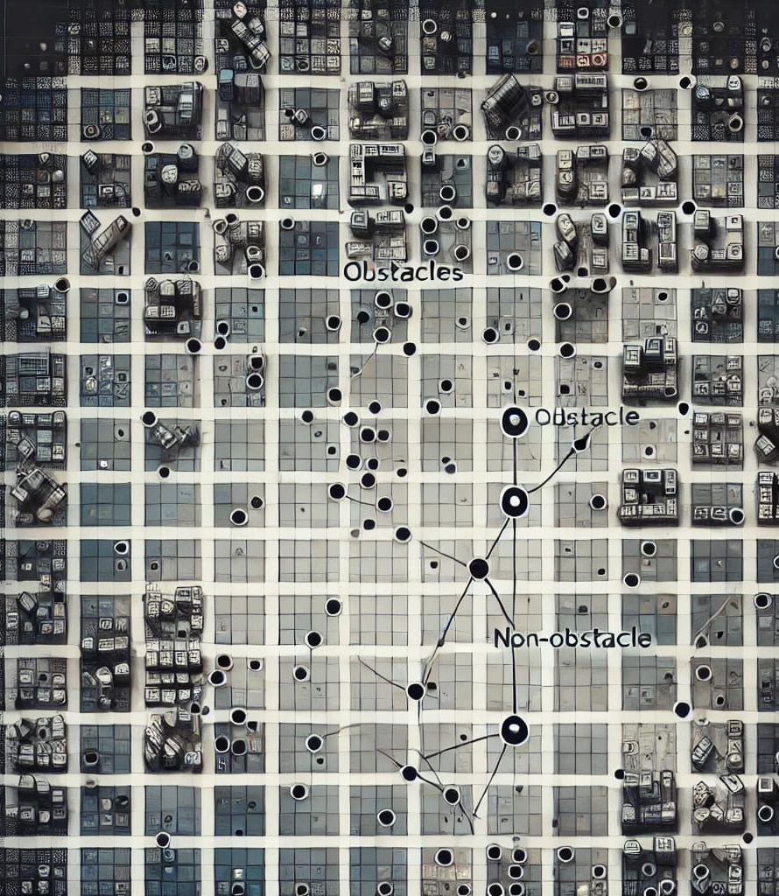
Visibility Learning

Slide 2
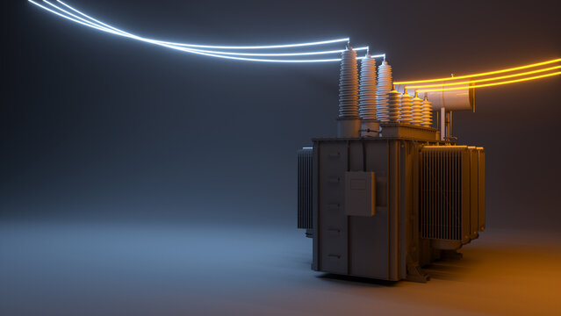
Transformer based architecture

Slide 3
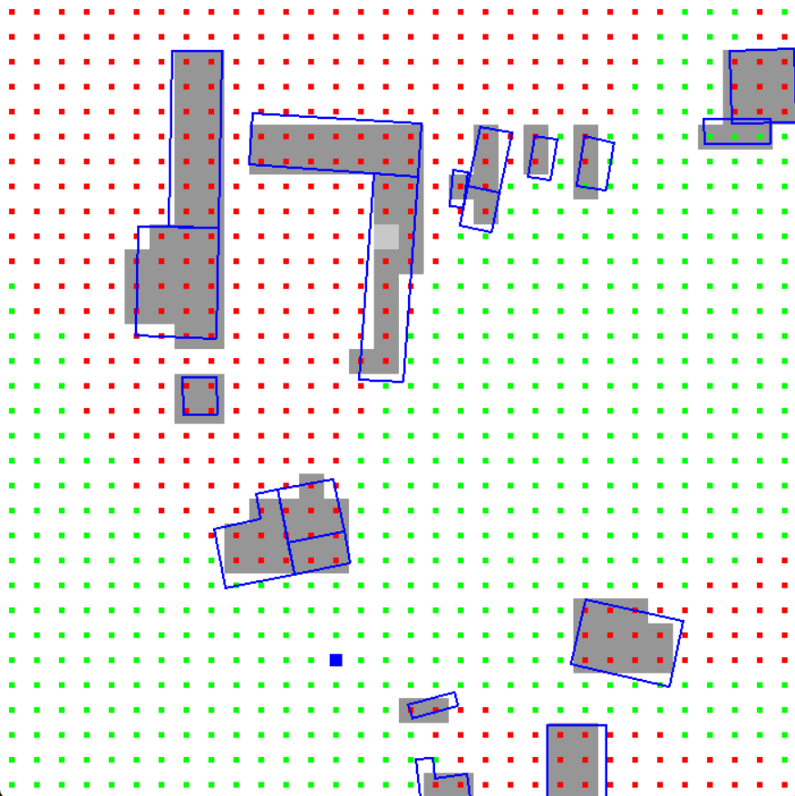
Transformer based architecture
Motivation:
In our CNN approach, we predict visibility between some fixed cells.
Not between any two continuous points

Slide 4
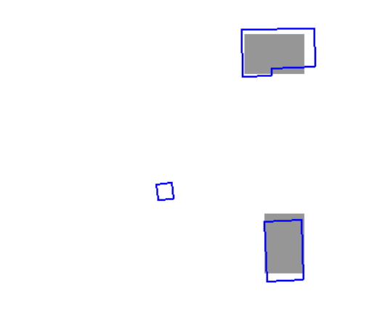
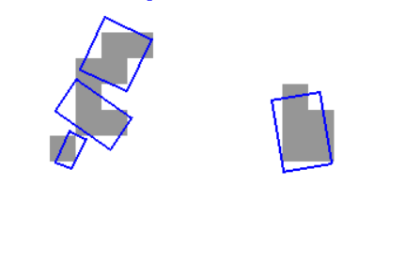
Transformer based architecture
Motivation:
Scan conversion loses accuracy because of resolution dependency
Doesn’t create encoding for obstacles smaller than cell
Incorrectly labels visibility in dataset (in our approach of dataset generation)

Slide 5
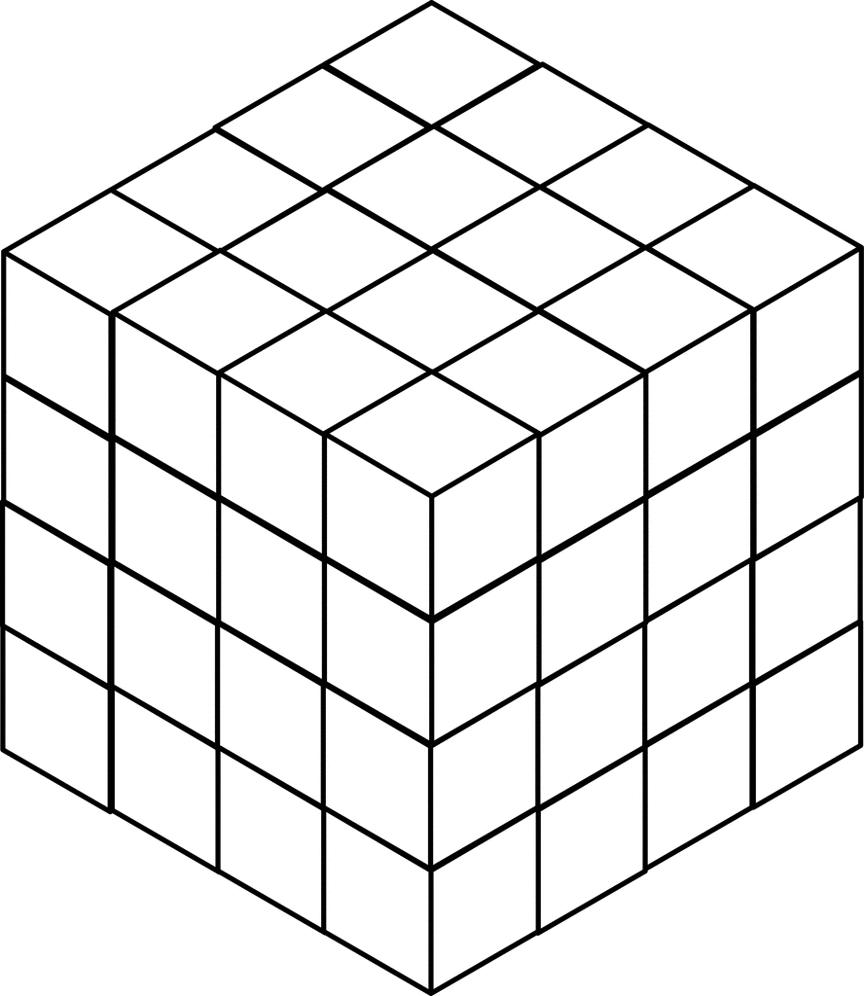
Transformer based architecture
Motivation:
Doesn’t scale well for 3D scenes.
Number of input feature becomes huge
N³ encoding cells for 3D in place of N² for 2D

Slide 6
Transformer based architecture
(x1, y1)
Idea:
Use Line as token
Each obstacles are made of a number of lines
(x2, y2)
Token (line) representation
x1 | y1 | x2 | y2

Slide 7
Transformer based architecture
(x1, y1)
Idea:
Decompose obstacles into lines
Attention mechanism will learn which other lines each line needs to pay attention to
(x2, y2)

Slide 8
Transformer based architecture
(x1, y1)
Idea:
Decompose obstacles into lines
Attention mechanism will learn which other lines each line needs to pay attention to
Query line will learn which lines it might intersect with
(x2, y2)

Slide 9
Transformer based architecture
Words need to consider positional ordering
Idea:
No need to apply positional encoding as there is no positional order between the lines
Token-1 | Token-2 | Token-3 | Token-4
Cow | eats | green | grass
Lines doesn’t need to remember positional ordering
N/A | N/A | N/A | N/A
Line 1 | Line 2 | Line 3 | Line 4

Slide 10
Transformer based architecture
Obs. 1
...
Line 1
Line 2
...
Query line
Idea:
Run classification head on enriched query line embedding
Transformer encoder
Enriched embedding
Line 1
Line 2
...
Query line
Classification head
0/1

Slide 11
Transformer based architecture
Idea:
Scalable for 3D scenes
Consider polyhedron faces as token
Query line can also be considered as a collapsed face where all vertices are on a line

Slide 12
Transformer based architecture
Training: 6000 scenes, 1200 Query points per scene
Testing: 2500 scenes, 1000 Query points per scene per density section
Test Results
Metric | 5-10% | 10-20% | 20-30% | 30-40% | 40-50%
Loss | 0.2593 | 0.2579 | 0.2451 | 0.2404 | 0.2372
Accuracy | 0.8869 | 0.8869 | 0.8929 | 0.8958 | 0.8987
Recall | 0.8966 | 0.8810 | 0.8741 | 0.8713 | 0.8690
Specificity | 0.8762 | 0.8913 | 0.9055 | 0.9121 | 0.9187
Precision | 0.8886 | 0.8547 | 0.8611 | 0.8691 | 0.8773
F1-Score | 0.8926 | 0.8676 | 0.8675 | 0.8702 | 0.8731

